Slide 1

DATA STRUCTURES & ITS APPLICATIONS
UE20CS202
Kusuma K V
Department of Computer Science
& Engineering

Slide 2

DATA STRUCTURES & ITS APPLICATIONS
AVL Trees
Kusuma K V
Department of Computer Science & Engineering

Slide 3
DATA STRUCTURES & ITS APPLICATIONS
Self-Balancing Binary Search Trees
A self-balancing binary search tree or height-balanced binary search tree is a binary search tree (BST) that attempts to keep its height, or the number of levels of nodes beneath the root, as small as possible at all times, automatically
The disadvantage of a binary search tree is that its height can be as large as N-1
Most operations on a BST take time proportional to the height of the tree, so it is desirable to keep the height small
This means that the time needed to perform insertion, deletion and many other operations can be O(N) in the worst case

Slide 4
DATA STRUCTURES & ITS APPLICATIONS
Self-Balancing Binary Search Trees
We want a tree with small height
A binary tree with N nodes has height at least Θ(log N)
Thus, our goal is to keep the height of a binary search tree O(log N)
Such trees are called balanced binary search trees. Examples are AVL tree, red-black tree
A typical operation done by trees to maintain balance is rotation

Slide 5
DATA STRUCTURES & ITS APPLICATIONS
AVL Tree
An AVL tree (named after inventors Adelson-Velsky and Landis) is a self-balancing binary search tree
It was the first such data structure to be invented
In an AVL tree, the heights of the two child subtrees of any node differ by at most one; if at any time they differ by more than one, rebalancing is done to restore this property
Lookup, insertion, and deletion all take O(log n) time in both the average and worst cases, where n is the number of nodes in the tree prior to the operation
Insertions and deletions may require the tree to be rebalanced by one or more tree rotations
https://en.wikipedia.org/wiki/AVL_tree

Slide 6
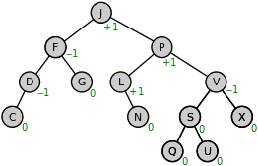
DATA STRUCTURES & ITS APPLICATIONS
AVL Tree
Balance Factor
In a binary tree the balance factor of a node X is defined to be the height difference
BF(X) := Height(RightSubtree(X)) - Height(LeftSubtree(X)) of its two child sub-trees
A binary tree is defined to be an AVL tree if the invariant
BF(X) = {-1,0,1} holds for every node X in the tree
A node X with BF(X) < 0 is called "left-heavy", one with BF(X) > 0 is called "right-heavy", and one with BF(X) = 0 is sometimes simply called "balanced"
Note: It can also be BF(X) := Height(LeftSubtree(X)) - Height(RightSubtree(X))
In which case, the terminologies left heavy and right heavy will mean in reverse way
https://en.wikipedia.org/wiki/AVL_tree

Slide 7
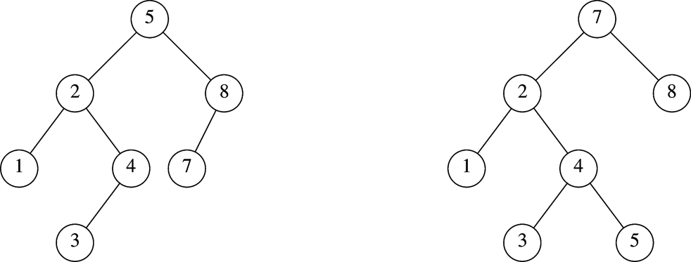
DATA STRUCTURES & ITS APPLICATIONS
AVL Tree
AVL tree
Not an AVL tree
https://en.wikipedia.org/wiki/AVL_tree

Slide 8
DATA STRUCTURES & ITS APPLICATIONS
AVL Tree
Types of imbalance and Rotations involved
LL imbalance : Right rotation (Single rotation)
RR imbalance: Left rotation (Single rotation)
LR imbalance: LR rotation (Double rotation)
RL imbalance: RL rotation (Double rotation)

Slide 9
DATA STRUCTURES & ITS APPLICATIONS
AVL Tree
LL imbalance : Right rotation (Single rotation)

Slide 10
DATA STRUCTURES & ITS APPLICATIONS
AVL Tree
RR imbalance : Left rotation (Single rotation)

Slide 11
DATA STRUCTURES & ITS APPLICATIONS
AVL Tree
LR imbalance : LR rotation (Double rotation)

Slide 12
DATA STRUCTURES & ITS APPLICATIONS
AVL Tree
RL imbalance : RL rotation (Double rotation)

Slide 13
DATA STRUCTURES & ITS APPLICATIONS
AVL Tree
Sequentially insert 5, 6, 8, 3, 2, 4, 7 to an AVL Tree

Slide 14
DATA STRUCTURES & ITS APPLICATIONS
Self-Balancing Binary Search Trees: AVL Tree
Sequentially insert 5, 6, 8, 3, 2, 4, 7 to an AVL Tree

Slide 15
DATA STRUCTURES & ITS APPLICATIONS
Self-Balancing Binary Search Trees: AVL Tree
Sequentially insert A, Z, B, Y, C, X to an AVL Tree
For steps the following visualization site may help, as said in the class !!
https://www.cs.usfca.edu/~galles/visualization/AVLtree.html

Slide 16
DATA STRUCTURES & ITS APPLICATIONS
AVL Tree
Sequentially insert A, Z, B, Y, C, X, D, W to an AVL Tree

Slide 17
DATA STRUCTURES & ITS APPLICATIONS
AVL Tree
AVL trees are often compared with red–black trees because both support the same set of operations and take O(logn) time for the basic operations
For lookup-intensive applications, AVL trees are faster than red–black trees because they are more strictly balanced
https://en.wikipedia.org/wiki/AVL_tree

Slide 18
DATA STRUCTURES & ITS APPLICATIONS
AVL Tree
Applications
AVL trees are used extensively in database applications in which insertions and deletions are fewer but there are frequent lookups for data required
It is used in applications that require improved searching apart from the database applications

Slide 19
DATA STRUCTURES & ITS APPLICATIONS
Graphs
Given graph G = (V , E )
• May be either directed or undirected
• Two common ways to represent:
1. Adjacency lists
2. Adjacency matrix
Adjacency-list representation provides a compact way to represent sparse graphs—those for which |E| much less than |V|² - it is usually the method of choice
Adjacency matrix representation is preferred when the graph is dense - |E| close to |V|² or when we need to be able to tell quickly if there is an edge connecting two given vertices

Slide 20
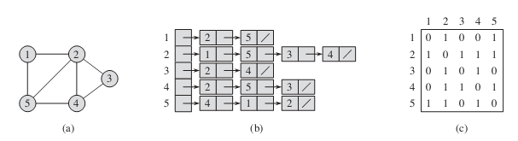
DATA STRUCTURES & ITS APPLICATIONS
Graphs - representation
Two representations of an undirected graph
An undirected graph G with 5 vertices and 7 edges
An adjacency – list representation of G
The adjacency matrix representation of G
The adjacency-list representation of a graph G=(V,E) consists of an array Adj of |V| lists, one for each vertex in V
Adj[u] consists of all the vertices adjacent to u in G (Alternatively, it may contain pointers to these vertices)
If vertices are numbered 1, 2, … , |V| in some arbitrary manner then the adjacency matrix representation of a graph G consists of a |V| x |V| matrix A=(a_{ij}) such that
1 if(i,j) ∈ E
a_{ij} =
0 otherwise

Slide 21
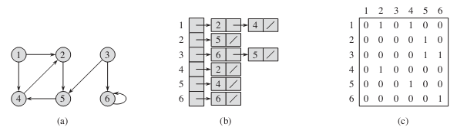
DATA STRUCTURES & ITS APPLICATIONS
Graphs - representation
Two representations of a directed graph
A directed graph G with 6 vertices and 8 edges
An adjacency – list representation of G
The adjacency matrix representation of G

Slide 22
DATA STRUCTURES & ITS APPLICATIONS
Graphs - representation
If G is a directed graph, the sum of the lengths of all the adjacency lists is |E| since an edge of the form (u,v) is represented by having v appear in Adj[u]
If G is an undirected graph, the sum of the lengths of all the adjacency lists is 2|E| ,since if (u,v) is an undirected edge, then u appears in v’s adjacency list and vice versa
For both directed and undirected graphs, the adjacency-list representation has the desirable property that the amount of memory it requires is ‚ Θ(V+E)

Slide 23
DATA STRUCTURES & ITS APPLICATIONS
Graphs - representation
A potential disadvantage of the adjacency-list representation is that it provides no quicker way to determine whether a given edge (u,v) is present in the graph than to search for v in the adjacency list Adj[u]
An adjacency-matrix representation of the graph remedies this disadvantage, but at the cost of using asymptotically more memory
The adjacency matrix of a graph requires Θ(V²) memory, independent of the number of edges in the graph

Slide 24
DATA STRUCTURES & ITS APPLICATIONS
Breadth First Search
Breadth First Search (BFS)
Algorithm used for traversing a graph data structure
It starts at the tree root (or some arbitrary node of a graph) and explores all of the neighbor nodes at the present depth prior to moving on to the nodes at the next depth level
Moore discovered BFS in the context of finding paths through mazes
Lee independently discovered the same algorithm in the context of routing wires on circuit boards
Similar to level order traversal on trees

Slide 25
DATA STRUCTURES & ITS APPLICATIONS
Depth First Search
Depth First Search (DFS)
Algorithm for traversing (or searching) tree (or graph) data structures
The algorithm starts at the root node (selecting some arbitrary node as the root node in the case of a graph) and explores as far as possible along each branch before backtracking
DFS is widely used in artificial intelligence problems
Similar to pre order traversal in trees

Slide 26
DATA STRUCTURES & ITS APPLICATIONS
Applications of BFS, DFS
Applications of Breadth First Search (BFS)
Path Finding Algorithms
Finding shortest path between two nodes
In social networks, we can find people within a given distance ‘k’ from a person using Breadth First Search till ‘k’ levels
…
…
Applications of Depth First Search (DFS)
Path Finding Algorithms
To find the connected components in a graph
Topological sorting
To detect cycles in a graph
…
…

Slide 27
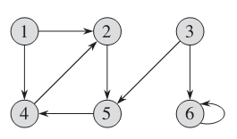
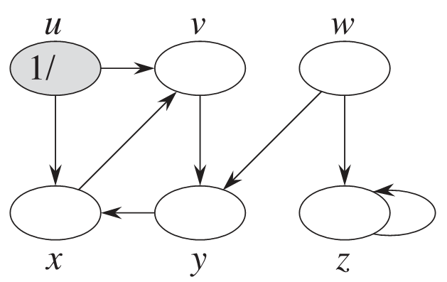
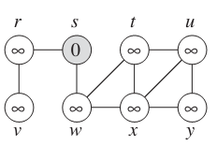
DATA STRUCTURES & ITS APPLICATIONS
BFS
BFS example: Consider 3 to be the source vertex
Consider s to be the source vertex
Consider u to be the source vertex

Slide 28
DATA STRUCTURES & ITS APPLICATIONS
DFS
DFS example: Consider 3 to be the source vertex
Consider s to be the source vertex
Consider u to be the source vertex

Slide 29
THANK YOU
Kusuma K V
Department of Computer Science
& Engineering
kusumakv@pes.edu

